Slide 1



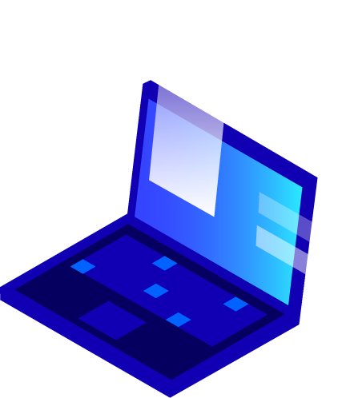


Smart AR Glasses using Arduino

Slide 2
Description
Encoding and Transmitting the Notifications received
Whenever a phone call is received on the user’s mobile, it primarily gets displayed as a notification. A Smart-Phone application is used to encode and transmit data of the phone – Time and Notifications of Phone call.
1
Receiving the content transmitted via Bluetooth
A Bluetooth module, named HC-05 is interfaced with the Arduino microcontroller ATmega328p, which is used to connect with smart-phones. A battery / Re-chargeable battery of 9V is used as power supply for Smart-Glass.
2
Decoding and Processing the data
The data received is decoded. An SSD1306, 0.96” OLED display is interfaced with ATmega328p, which is used to display this decoded data.
3

Slide 3
Components Required
Arduino Nano (ATmega328p)
9V Battery
Bluetooth Module HC-05
OLED display (SSD1306)
Wires for connection
Basic Frame (for design purpose)

Slide 4
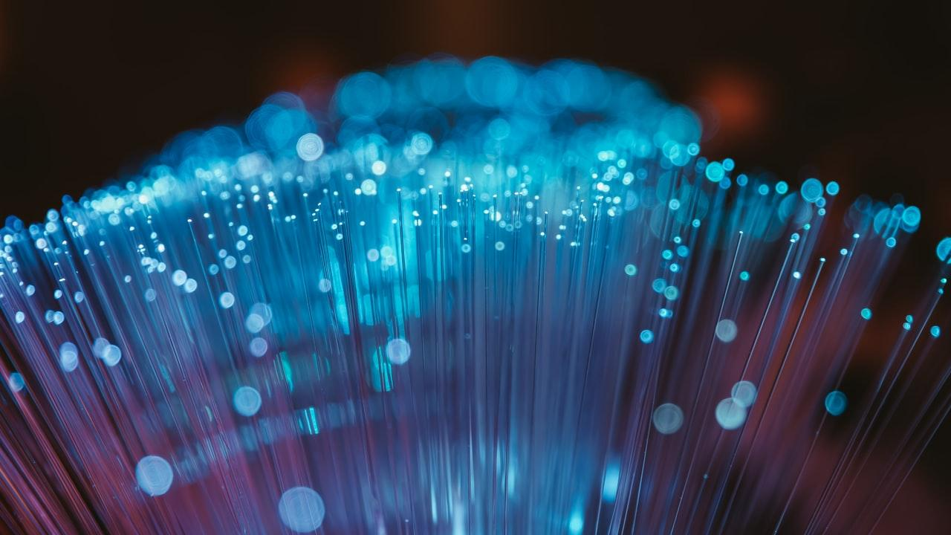
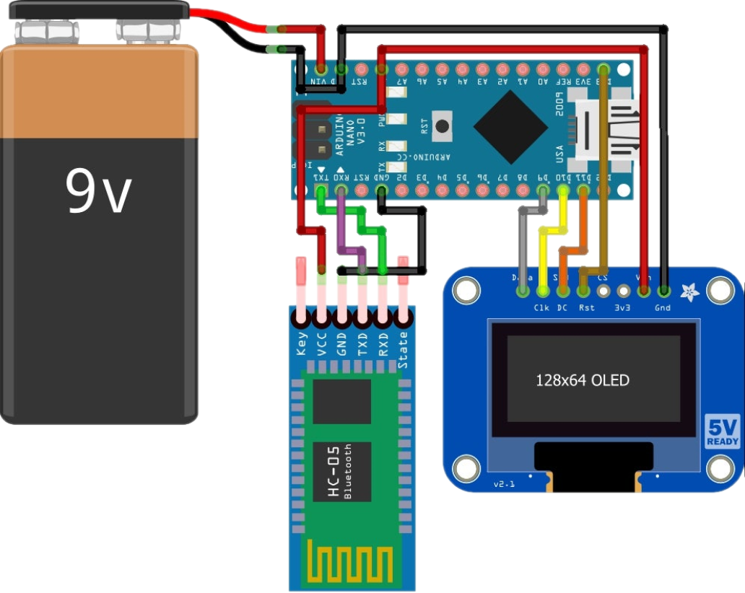
PIN DIAGRAM

Slide 5
Program
#include <SPI.h>
#include <Wire.h>
#include <Adafruit_GFX.h>
#include <Adafruit_SSD1306.h>
#define OLED_RESET 4
Adafruit_SSD1306 display(OLED_RESET);
void setup() {
Serial.begin(9600);
display.begin(SSD1306_SWITCHCAPVCC, 0x3D);
display.display();
delay(2000);
display.clearDisplay();
}
void loop() {
while(Serial.available() > 0){
String Time = Serial.readStringUntil('|');
String Phone = Serial.readStringUntil(‘\n’);
Serial.flush();
}
if(Phone == "phone") {
display.println(Time);
display.display();
display.clearDisplay();
}
else {
display.println(Phone);
display.display();
delay(5000);
display.clearDisplay();
}
}

Slide 6
3D Model
The 3D model of the prototype will be demonstrated

Slide 7
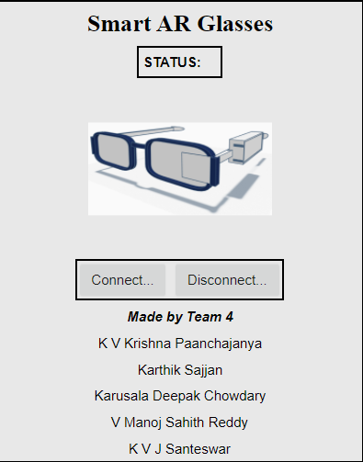
Mobile Application
Call Notification Received?
Yes
No
Encoded Time, Phone number
Encoded Time
Transmitting and Receiving
3
Decode and Process
Execution

Slide 8

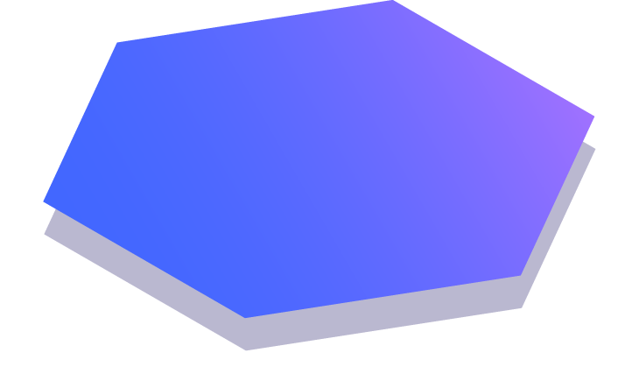
Thanks!
Project By
Karthik Sajjan 19BCS049
Karusala Deepak Chowdary 19BCS050
Khiladi Venkata Jai Santeswar 19BCS053
Kuppa Venkata Krishna Paanchajanya 19BCS063
Vanga Manoj Sahith Reddy 19BCS110

